Slide 1


Slide 2

DOM
(Part -1)

Slide 3
DOM Introduction
JavaScript is mostly used for allowing our visitors to interact with our web page.
In order to be able to do this we need to have some mechanism by which our JavaScript code can access the components of the web page.
This is done using DOM (Document Object Model)

Slide 4
What Is DOM ?
When a Web browser loads an HTML file, it displays the contents of that file on the screen.
But that’s not all the Web browser does with the tags, attributes, and contents of the file: it also creates and memorizes a “model” of that page’s HTML.
In other words, the Web browser remembers the HTML tags, their attributes, and the order in which they appear in the file—this representation of the page is called the Document Object Model, or DOM in short

Slide 5
Example(Human View)
<html>
<head>
<title>An Example XHTML Document</title>
<link rel="stylesheet" href="style.css" type="text/css" />
</head>
<body>
<p>This is an example paragraph.</p>
<p>This is an example paragraph with
<a href="stuff.html">a hyperlink</a> inside of it!</p>
<p>And here's one with<br />a line break
and an <img src="image.jpg" alt="image">.</p>
</body>
</html>

Slide 6
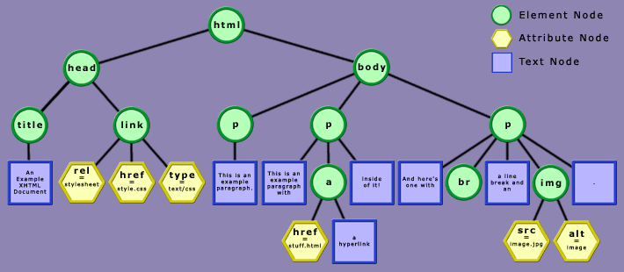
Browser View

Slide 7
Explanation
In the HTML DOM, everything is a node.
The entire document is a document node
Every HTML element is an element node
The text inside HTML elements are text nodes
Every HTML attribute is an attribute node

Slide 8
What Can Be Done With DOM ?
With DOM , a programmer gets all the power he needs to create dynamic HTML:
Using DOM we can create new HTML elements in the page
Using DOM we can can change all the HTML attributes in the page
Using DOM we can can change all the CSS styles in the page
Using DOM we can can react to all the events in the page

Slide 9
Working With DOM
To work with DOM we just have to follow a 2 step approach
a. Select the desired DOM element
b. Access/Change the properties of that element
When we change the properties of these elements , JS updates DOM and so we say that DOM is a Live Data Structure

Slide 10
How Can We Select DOM Elements ?
Selection of DOM Elements can be done in 6 ways:
Selecting using dot syntax
Selecting using CSS selectors
Selecting using id
Selecting using tag name
Selecting using class name
Selecting using form

Slide 11
Selecting Using Dot Syntax
We know that document is an object and thus this object gives us certain properties for accessing the HTML ELEMENTS of the page.
These are:
document.body : returns the body object
document.images: returns an array of all the image objects
document.links: returns an array of all the link objects
document.forms: returns an array of all the form objects

Slide 12
Selecting Using CSS Selectors
In CSS, we know that , selectors are patterns used to select the element(s) we want to style, but, selectors are also useful in JavaScript.
JavaScript provides us two methods which allow us to select HTML elements via CSS Selectors.
These methods are:
querySelector(): Returns the first element that matches the provided CSS selector. Otherwise returns null
querySelectorAll(): Returns a non-live collection of all the elements that match the provided selector as a NodeList object. Otherwise returns an empty NodeList

Slide 13
A NodeList object is a list (collection) of nodes extracted from a document.
What Is NodeList ?
A NodeList is an object just like Date , Math and other objects in JS
A NodeList is a list (collection) of nodes extracted from a document.
It is very much like an array and uses the same length property, iterate over it using for..of or forEach() but there are still certain differences.
For example : We can not use the common array methods like push(), pop(), slice(), and join() directly on a NodeList

Slide 14
The querySelector() Method
The querySelector() method takes an argument, which is a string that represents the CSS selector for the element we wish to find.
What gets returned by querySelector() is the first element it finds
Syntax:
element.querySelector(selectors)
Example:
let element = document.querySelector("#main");
The above code will select that element whose id is “main”

Slide 15
The querySelectorAll() Method
The querySelectorAll() method returns all elements in the document that matches a specified CSS selector(s), as a static NodeList object.
The NodeList object represents a collection of nodes and these nodes can be accessed by index numbers which starts at 0.

Slide 16
The querySelectorAll() Method
Syntax:
element.querySelectorAll(selectors)
Example:
let divs = document.querySelectorAll(“div");
The above code will select that div tags
We can use the length property of the NodeList object to determine the number of elements that matches the specified selector, then we can loop through all elements and extract the info we want.

Slide 17
DOM Selection Methods
Selection of elements can be done by 3 methods:
getElementById( idvalue)
This method selects and returns only that element whose id value matches with the string passed as argument.
Example:
let x=document.getElementById(“p1”);

Slide 18
DOM Selection Methods
getElementsByTagName( tag name)
This method selects and returns an HTMLCollection of those HTML elements whose tag matches with the string passed as argument.
Example:
let x=document.getElementsByTagName(“p”);

Slide 19
A NodeList object is a list (collection) of nodes extracted from a document.
What Is HTMLCollection ?
An HTMLCollection is an object just like Date , Math and other objects in JS
It is an array-like object that represents a collection of HTML elements that are extracted from the document.
Although it may look like an array, but it is not an array.
Both are two completely different things.

Slide 20
A NodeList object is a list (collection) of nodes extracted from a document.
What Is HTMLCollection ?
Just like an array, we can iterate through the HTMLCollection using simple for or for..of loops and refer to its elements by an index number.
But we can not use the common array methods like forEach() , push(), pop(), slice(), and join() directly on a HTMLCollection

Slide 21
DOM Selection Methods
getElementsByClassName( class name)
This method selects and returns an HTMLCollection of those HTML elements whose class name matches with the string passed as argument.
Example:
let x=document.getElementsByClassName(“cl”);

